Slide 1
Twitter Sentiment Analysis using Python
Avinash Pandey

Slide 2
What is Sentiment Analysis?
Sentiment Analysis is the process of determining whether a piece of writing (product/movie review, tweet, etc.) is positive, negative or neutral.
It can be used to identify the customer or follower's attitude towards a brand through the use of variables such as context, tone, emotion, etc.

Slide 3
Marketers can use sentiment analysis to research public opinion of their company and products, or to analyze customer satisfaction.
Organizations can also use this analysis to gather critical feedback about problems in newly released products.
Sentiment analysis not only helps companies to understand how they’re doing with their customers, it also gives them a better picture of how they stack up against their competitors.

Slide 4
For example, if your company has 20% negative sentiment, is that bad?
It depends.
If your competitors have a roughly 50% positive and 10% negative sentiment, while yours is 20% negative, that merits more discovery to understand the drivers of these opinions.
Knowing the sentiments associated with competitors helps companies evaluate their own performance and search for ways to improve.

Slide 5
Applications of Sentiment Analysis
Sentiment Analysis finds its application in a variety of domains.
Online Commerce
Brand Reputation Management
Government

Slide 6
Characteristic features of Tweets
Length of a Tweet
Language used
Data availability
Domain of topics

Slide 7
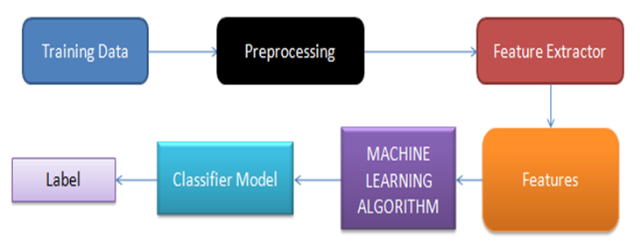
Approach
Figure : Block Representation of Sentiment Analysis

Slide 8
Datasets
One of the major challenges in Sentiment Analysis of Twitter is to collect a labelled dataset. Following are the some of the benchmark labelled datsets.
Testdata.manual.2009.06.14, http://help.sentiment140.com/for-students/.
Twitter dataset, https://drive.google.com/file/d/0BwPSGZHAP_yoN2pZcVl1Qmp1OEU/view?usp=sharing.
Twitter-sanders-apple,
http://boston.lti.cs.cmu.edu/classes/95-865-K/HW/HW3/

Slide 9
Pre Processing
The raw tweets, collected from Twitter, have noise in terms of unwanted and fuzzy words, URLs, stopwords etc., which are needed to be reduced before feature extraction.
Sample Tweet-
RT @mashable: Five Things Wolfram Alpha Does Better (And Vastly Different) Than Google ☺ http://bit.ly/6nSnR. #wolfram alpha

Slide 10
This phase eliminates unwanted noise elements from the Twitter data set using the following steps:
Eliminate all the URLs via regular expression matching. A regular expression is a textual pattern that defines a search pattern for strings/text. It can be used to search for URLs, email address etc.
tweet= = re.sub(’((www\.[^\s]+)|(https?://[^\s]+))’,’url’,tweet)
Replace “@Username” with “usr” using regular expression matching.
tweet = re.sub('@[^\s]+', ‘usr’,tweet)

Slide 11
Since “hash-tag (#)” provides some useful information, therefore remove only #, keeping the word as it is. viz., “ #Lee” is replaced with “Lee”.
tweet = re.sub(r'#([^\s]+)', r'\1', tweet)
Replace multiple white spaces with single white space
tweet = re.sub('[\s]+', ' ', tweet)

Slide 12
Use of emoticons is very prevalent throughout the web, and over micro- blogging sites. We identify the following emoticons and replace them with a single word.
Emoticons | Examples
EMOT_SMILEY | :-) | :) | (: | (-:
EMOT_LAUGH | :-D | :D | X-D | XD | xD
EMOT_LOVE | <3 | :*
EMOT_WINK | ;-) | ;) | ;-D | ;D | (; | (-;
EMOT_FROWN | :-( | :( | (: | (-:
EMOT_CRY | :,( | :'( | :"( | :((

Slide 13
Remove Punctuations such as parenthesis, forward slash (/), backward slash (\), and dash from tweets.
tweet = tweet.strip(’-’ ’()’ ’\’ ’/’)
Some of the Punctuations like question mark, exclamation mark can provide information about the sentiments of the text. Therefore, replace every word boundary by a list of relevant punctuations.
Punctuations | Examples
PUNC_DOT | .
PUNC_EXCL | ! | ¡
PUNC_QUES | ? | ¿
PUNC_ELLP | ... | …

Slide 14
Replace sequence of repeated characters (three or more) in a word by one character viz., “hellooooo” is converted to “Hello”.
pattern = re.compile(r"(.)\1{1,}", re.DOTALL)
pattern.sub(r"\1\1", s)
Convert all the words of tweets into lowercase.
Remove all the stop words such as, a, is, the, etc. by comparing them with stop word dictionary.
Eliminate words which do not start with an alphabet.

Slide 15
Stemming
Stemming is the process of reducing a word into its stem, i.e. its root form. For example, the words fish, fishes and fishing all stem into fish, which is a correct word. On the other side, the words study, studies and studying stems into studi, which is not an English word.
Most commonly, stemming algorithms (a.k.a. stemmers) are based on rules for suffix stripping.

Slide 16
Stemming Algorithms
Use Porter Stemmer to perform the following set of actions over tweets-
1.Gets rid of plurals and -ed or -ing suffixes
2.Turns terminal y to i when there is another vowel in the stem￼
3.Maps double suffixes to single ones: -ization, -ational, etc.
4.Deals with suffixes, -full, -ness etc.
5.￼Takes off -ant, -ence, etc.
6.Removes a final –e

Slide 17
from nltk.stem import PorterStemmer
from nltk.tokenize import sent_tokenize, word_tokenize
ps = PorterStemmer()
new_text = "It is important to by very pythonly while
you are pythoning with python. All pythoners have
pythoned poorly at least once."
words = word_tokenize(new_text)
for w in words:
print(ps.stem(w))
It
is
import
to
by
veri
pythonli
while
you
are
python
with
python

Slide 18
After stemming Lemmatization is performed. Lemmatization is the process of normalizing a word rather than just finding its stem.
In the process, a suffix may not only be removed, but may also be substituted with a different one. It may also involve first determining the part-of-speech for a word and then applying normalization rules.
It might also involve dictionary look-up. For example, verb ‘saw’ would be lemmatized to ‘see’ and the noun ‘saw’ will remain ‘saw’.

Slide 19
Part-of-speech Tagging
Part-of-speech (POS) tagging is the process of assigning a word to its grammatical category in order to understand its role within the sentence. Traditional parts of speech are nouns, verbs, adverbs, conjunctions, etc.
Part-of-speech taggers typically take a sequence of words (i.e. a sentence) as input, and provide a list of tuples as output, where each word is associated with the related tag.
from nltk.stem import PorterStemmer, WordNetLemmatizer
stemmer = PorterStemmer()
lemmatiser = WordNetLemmatizer()
print("Stem %s: %s" % ("studying", stemmer.stem("studying")))
print("Lemmatise %s: %s" % ("studying", lemmatiser.lemmatize("studying")))
print("Lemmatise %s: %s" % ("studying", lemmatiser.lemmatize("studying", pos="v")))
Stem studying: studi Lemmatise studying: studying Lemmatise studying: study

Slide 20
from nltk import pos_tag
from nltk.tokenize import word_tokenize
s = "This is a simple sentence"
tokens = word_tokenize(s) # Generate list of tokens
tokens_pos = pos_tag(tokens)
print(tokens_pos)
[('This', 'DT'), ('is', 'VBZ'), ('a', 'DT'), ('simple', 'JJ'), ('sentence', 'NN')]
DT determiner
VBZ verb
JJ adjective
NN noun

Slide 21
Feature extraction method
After applying the pre-processing, relevant features are extracted from the Twitter dataset.
A wide variety of features can be used to build a classifier for tweets.
The most widely used and basic feature set is word n-grams.

Slide 22
N-grams
N-gram are basically a set of co-occuring words within a given window and when computing the n-grams you typically move one word forward (although you can move X words forward in more advanced scenarios).
For example, for the sentence "The cow jumps over the moon". If N=2 (known as bigrams), then the ngrams would be:
the cow
cow jumps
jumps over
over the
the moon

Slide 23
In the domain of sentiment analysis, the performance of N-grams is unclear.
According to Pang et al. unigrams alone are better than bigrams for classification movie reviews, while some others report that bigrams and trigrams yield better product-review polarity classification.
For simplicity, the unigrams are generally considered for sentiment analysis. However, Bigrams and Trigrams can also be used.

Slide 24
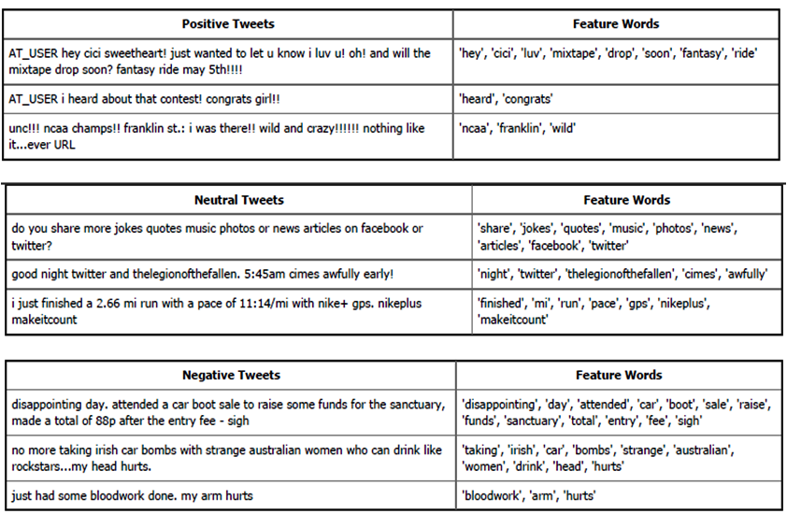

Slide 25
Tweet classification
Split the data into training and testing set. Usually, 80% data is used for training and remaining for testing.
Choose any classifier model (Naive-bayes classifier, Support vector machine, etc.) and train the model using training dataset.
After training, evaluate the performance of classifier using testing dataset.

Slide 26
How to Perform Sentiment Analysis?
There are many tools that provide automated sentiment analysis.
Textblob is widely used for automated sentiment analysis. Textblob provides access to common text processing operations through interface.
The first step of twitter sentiment analysis is to crawl tweets on Twitter or to use benchmark datasets.

Slide 27
Step 1: Crawl Tweets Against Hash Tags
To have access to the Twitter API, you'll need to login the https://apps.twitter.com/. and create an application.
Enter your desired Application Name, Description and your website address making sure to enter the full address including the http://. You can leave the callback URL empty.

Slide 28
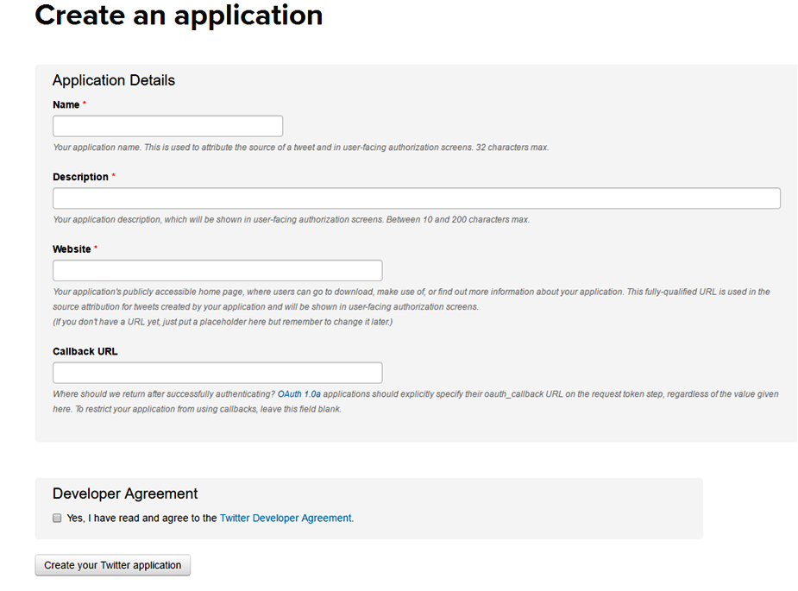

Slide 29
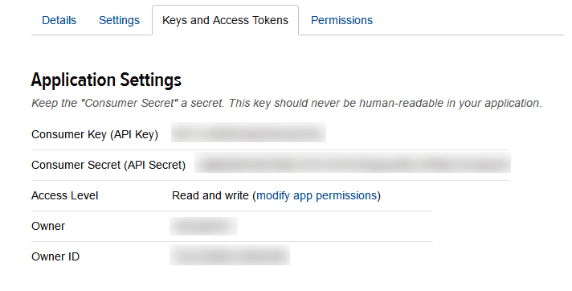
After registering, create an access token and grab your application’s Consumer Key, consumer Secret, Access token and Access token secret from Keys and Access Tokens tab.

Slide 30
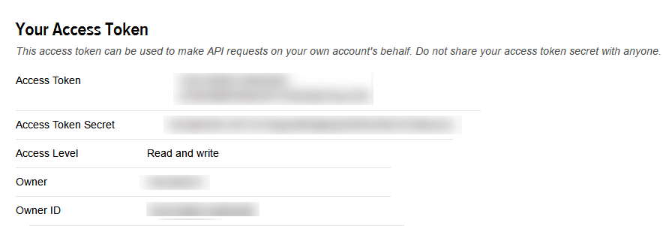

Slide 31
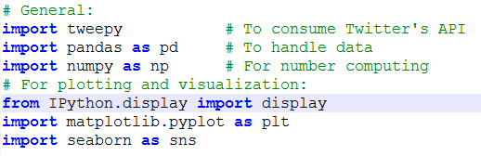
After creating application required libraries are imported.
Next step is keys authentication. In order to do this, we will create a function to allow us our keys authentication.

Slide 32
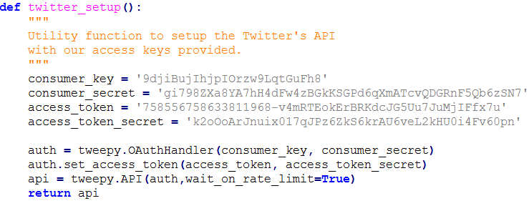
Once that api variable has been set to the object returned by tweepy.API(auth), you're free to make some Twitter API calls.

Slide 33
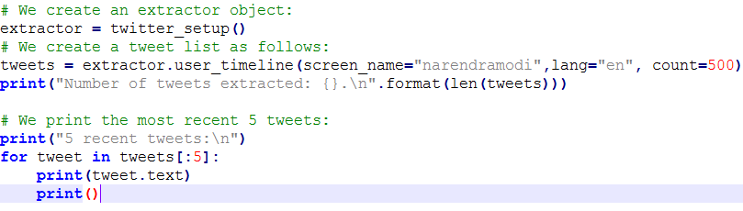
Tweets extraction
Next step is to extract tweets from Twitter's API. In order to do this, we will use extractor object and Tweepy's function to extract scrape tweets against a particular topic (screen_name's).
We now have an extractor and extracted data, which is listed in variable tweets. Each element in that list is a tweet object from Tweepy.

Slide 34
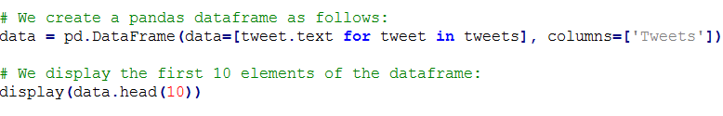
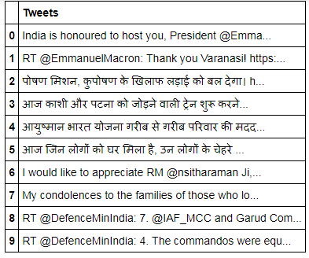
Creating a (pandas) DataFrame
A Data frame is a two-dimensional data structure, i.e., data is aligned in a tabular fashion in rows and columns.
Features of DataFrame
Potentially columns are of different types
Size – Mutable
Labeled axes (rows and columns)
Can Perform Arithmetic operations on rows and columns

Slide 35

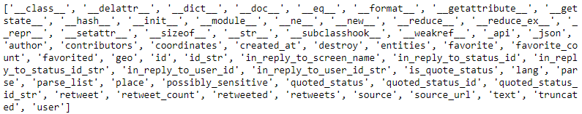
The internal methods of tweet structure in Tweepy can be obtained by following command-

Slide 36
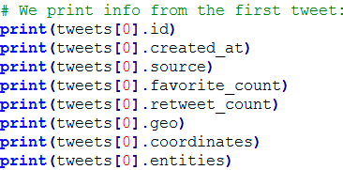
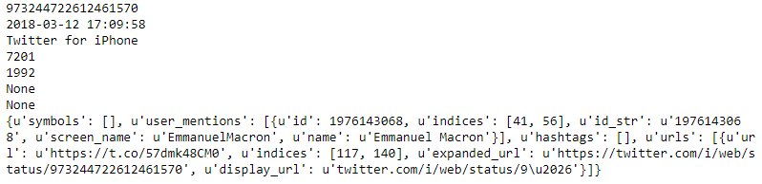
The quantity of metadata in a single tweet such as the creation date, id, etc. can be obtained using following commands-
Twitter entities
Entities provide metadata and additional contextual information about content posted on Twitter.
The entities section provides arrays of common things included in Tweets: hashtags, user mentions, links, stock tickers (symbols), Twitter polls, and attached media.

Slide 37
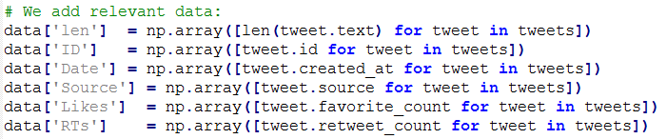
Adding relevant info to our dataframe
A lot of data from a single tweet. But not all this data is always useful for specific stuff. In our case we well just add some data to our dataframe.
For this we will use Pythons list comprehension and a new column will be added to the dataframe by just simply adding the name of the content between square brackets and assign the content.

Slide 38
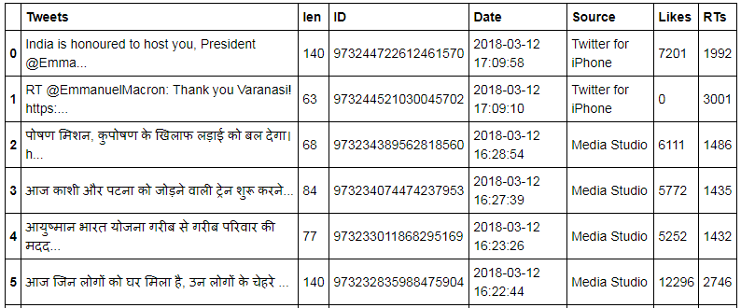
Display again the dataframe to see the changes.

Slide 39

Visualization and basic statistics
Averages and popularity
We first want to calculate some basic statistical data, such as the mean of the length of characters of all tweets, the tweet with more likes and retweets, etc.
The length‘s average in tweets: 126.08

Slide 40
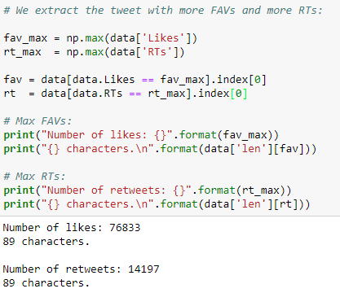

Slide 41
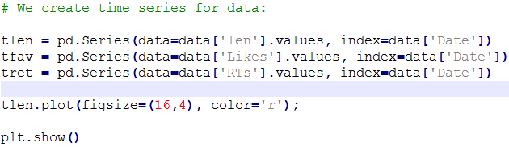
Time series
Pandas has its own object for time series. Since we have a whole vector with creation dates, we can construct time series respect tweets lengths, likes and retweets.

Slide 42
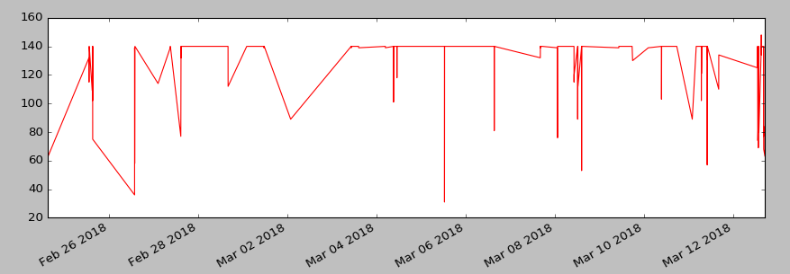
Time series and tweets lengths

Slide 43

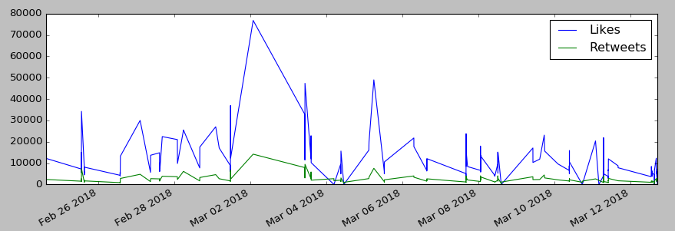
Likes and retweets

Slide 44
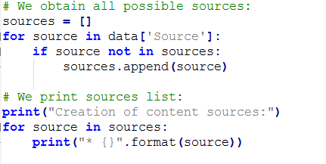
Pie charts of sources
Now we will plot the sources in a pie chart, since we realized that not every tweet is tweeted from the same source.

Slide 45
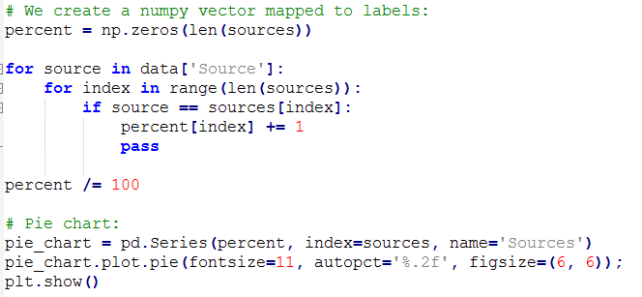
We now count the number of each source and create a pie chart. You'll notice that this code cell is not he most optimized one.

Slide 46
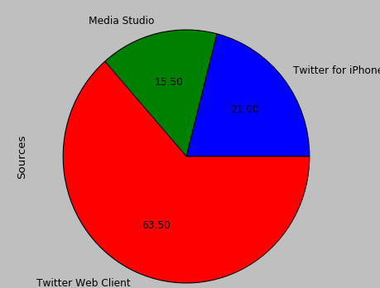
Pie charts of sources

Slide 47
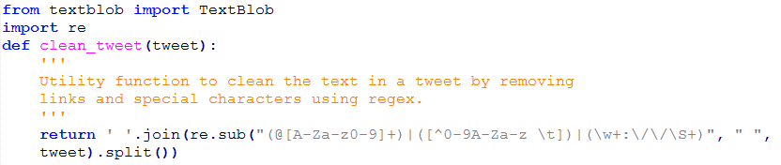
Sentiment analysis
For sentiment analysis we will use textblob.
We will also use the re library from Python, which is used for pre-processing the tweets.
For SA, two utility functions are used
a) clean_tweet() to pre-processing the tweets.
b) analize_sentiment () to analyze the polarity of each tweet after cleaning the text in it.

Slide 48
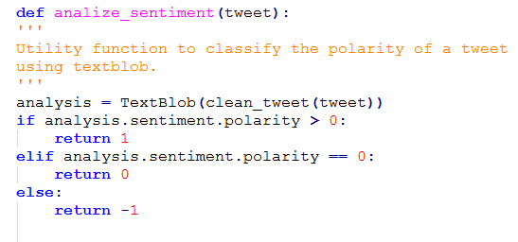
Textblob already provides a trained analyzer. Textblob can work with different machine learning models used in natural language processing.

Slide 49
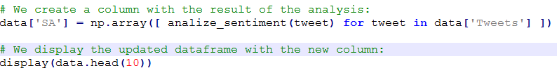
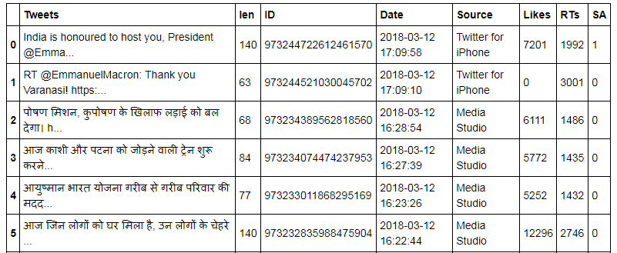
After finding the polarity of each tweets, it is added to our datasets. Hence, an extra column is added to our datasets which contain the sentiments of tweets.

Slide 50
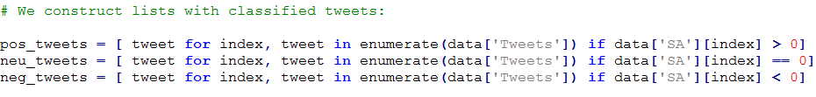
Analyzing the results
To have a simple way to verify the results, we will count the number of neutral, positive and negative tweets and extract the percentages.

Slide 51
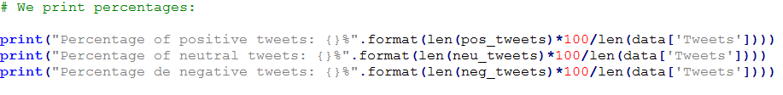

Print the percentages of results obtained.

